Slide 1
Introduction to LangGraph
Building Graph-Based AI Workflows & Agents
Pankaj Joshi
Data Scientist

Slide 2
What is LangGraph?
A framework built on top of LangChain
Enables creation of stateful, cyclic (looping) processes
Integrates with large language models (LLMs) and external tools

Slide 3
Why Was LangGraph Developed?
Addressing Limitations:
Traditional prompt chaining is fixed and rigid
Difficulty in managing state and iterative, looping processes
LangGraph’s Advantages:
Seamless state management and persistence
Support for cycles (loops) and conditional routing
Integrated human-in-the-loop control for critical decisions

Slide 4
Understanding AI Agents
What is an Agent?
An autonomous system that uses an LLM to decide the next action without any manual guidance
Operates in a loop: Action → Observation → Decision
Role in LangGraph:
Agents leverage LangGraph’s nodes and edges for dynamic workflows
Enable complex tasks like multi-step customer support.

Slide 5
Core Components of LangGraph
State:
A shared data structure representing the current context of the workflow
Stores and passes information between different components
Nodes:
Computational units that perform specific tasks
Can be simple functions or complex AI agents
Edges:
Define transitions between nodes
Include normal (fixed) edges and conditional edges for dynamic routing

Slide 6
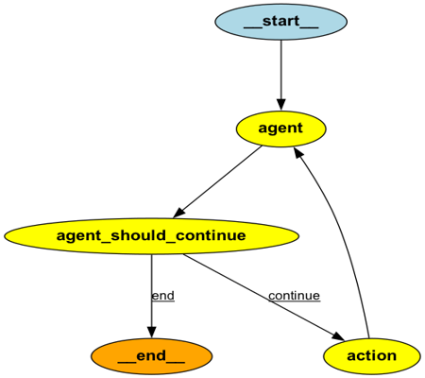
How LangGraph Works

Slide 7
Key Features & Benefits
Modularity & Flexibility:
Easily add or update nodes to handle new tasks
Customize conditional edges for complex decision-making
Cyclic Workflows:
Supports loops and iterations for multi-turn conversations
Persistence & Human-in-the-Loop:
Save and resume state for long-running interactions
Enable manual interventions when needed

Slide 8
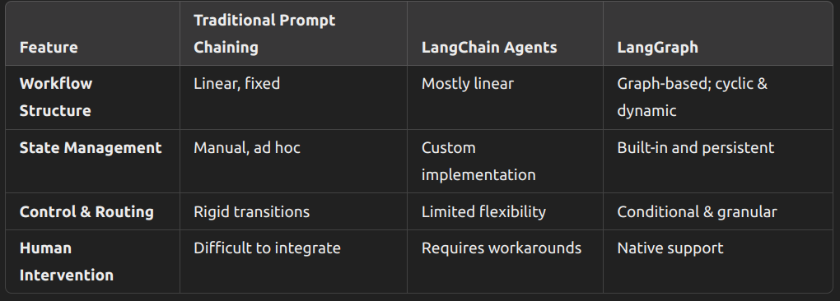
Comparison with Other Approaches

Slide 9
Thank you :)

